Slide 1

Real-time Sales and Marketing Analytics
- For Car Accessories & Spares

Slide 2

Tech Army – Team Details
Name | Role
Masthanvali Shaik | Group Lead
Vasanth Subramanian | Team Member
Mary | Team Member
Mehul | Team Member
Mentor | Jeyaprakash Sriramulu (JP)

Slide 3

Problem Statement
How to optimize production, inventory and selling price of Car accessories and spares?

Slide 4
Solution
Sourcing Sales, Inventory and Selling price Data from e-commerce vendors in real-time and forecasting the below values,
Just in time manufacturing of a given SKU based on market demand
Optimize inventory levels of SKUs to reduce dead inventory cost
Demand based pricing

Slide 5
Tools
Below tools are leveraged for this solution,
1. Google Sheet (Input Source Data)
2. FiveTran (Transmission, Connectors & Transformation)
2. Tableau (Business Intelligence – BI)

Slide 6
Data Flow Architecture Diagram​
Google Sheets (Data Source)
FiveTran (Data Integration)
Snowflake
(Datawarehouse)
Tableau (Data Visualization)
Extract
Load
Projection

Slide 7
Data Flow Process
Step 1: FiveTran connects to Google Sheets and extracts the data.​
Step 2: FiveTran transforms and schedules the data sync as per the defined pipeline.​
Step 3: FiveTran transmits the processed data to Snowflake.​
Step 4: Tableau updates dashboards/reports in real-time or near real-time based on new data from Snowflake.​

Slide 8
Sample Source Data
SKU | Product Name | Spare or Accessory | Current Stockist Quantity | Current Order Quantity | Current Unit Price | Current Selling Price | Vendor (e-commerce) | Lead Time(in days) | Order Date
1 | fuel pump | Spare | 84 | 52 | 177.34 | 23 | eBay | 1 | 23-04-2020
2 | spark plugs | Spare | 922 | 82 | 356.24 | 25 | Amazon | 2 | 23-10-2020
3 | exhaust system | Accessory | 752 | 11 | 403.5 | 88 | eBay | 3 | 08-03-2020
4 | brake pads | Spare | 608 | 63 | 102.23 | 53 | eBay | 4 | 22-09-2021
5 | air filter | Accessory | 183 | 61 | 60.14 | 39 | eBay | 5 | 31-03-2021

Slide 9
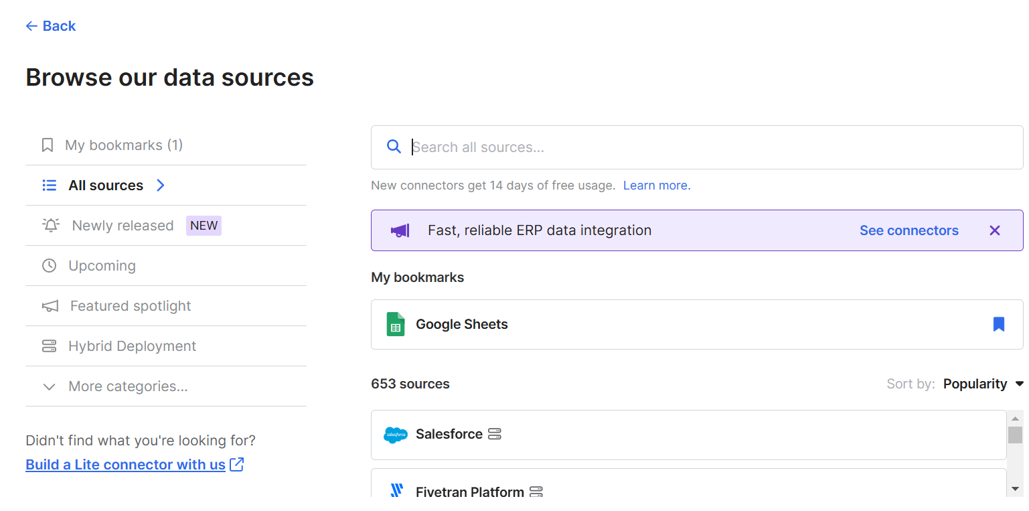
Choose Source
Source:
Google Sheets

Slide 10
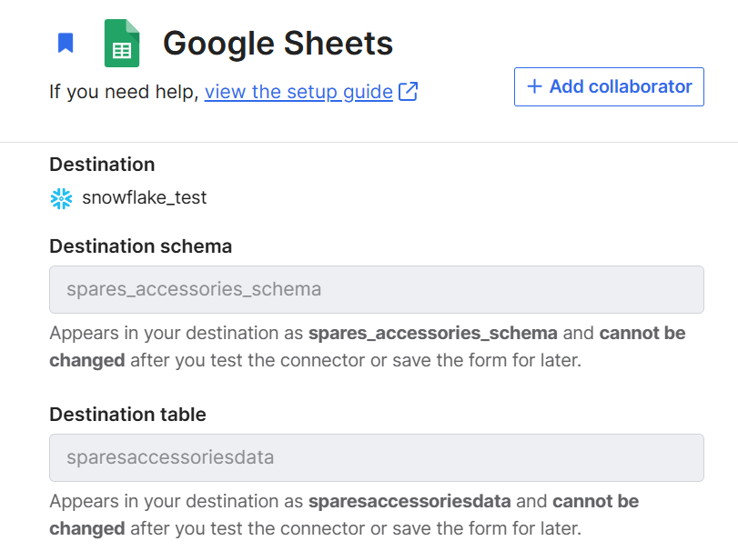
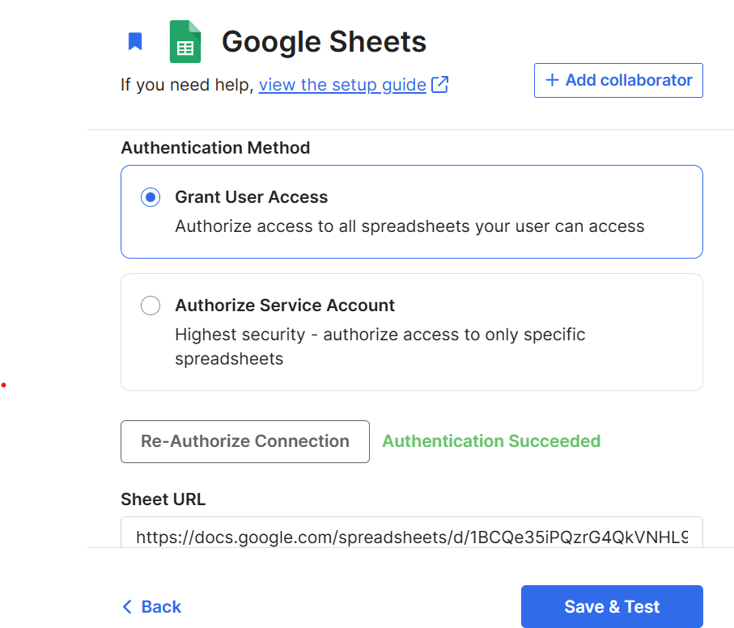
Destination: Snowflake

Slide 11
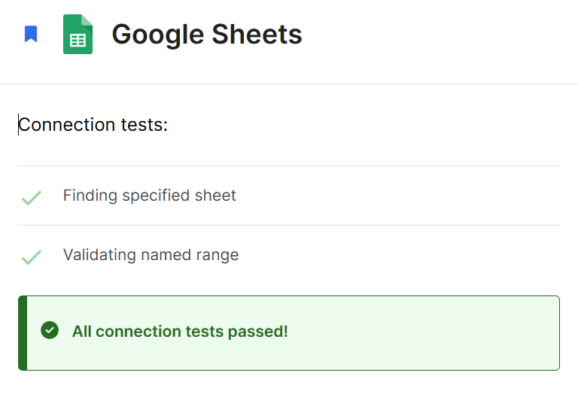
Connection Validation

Slide 12
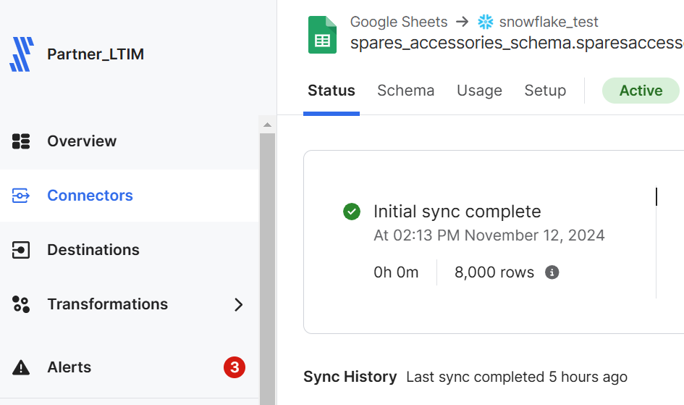
Sync Data
Source | Destination
Google Sheets | Snowflake

Slide 13
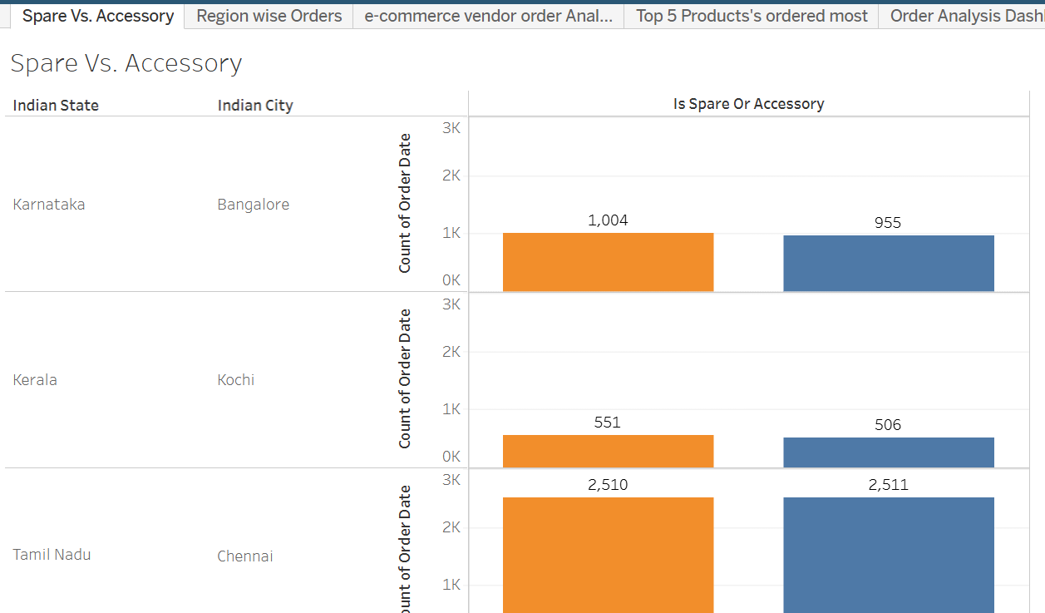
Tableau Dashboard
Spare Vs.
Accessory
Spare Vs. Accessory – Order Quantity Analysis, in Region wise

Slide 14
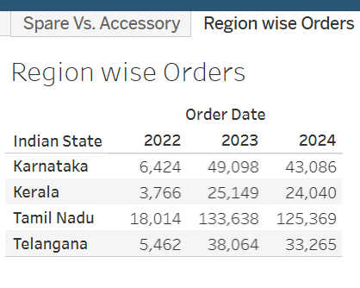
Region wise Order Analysis
Tableau Dashboard

Slide 15
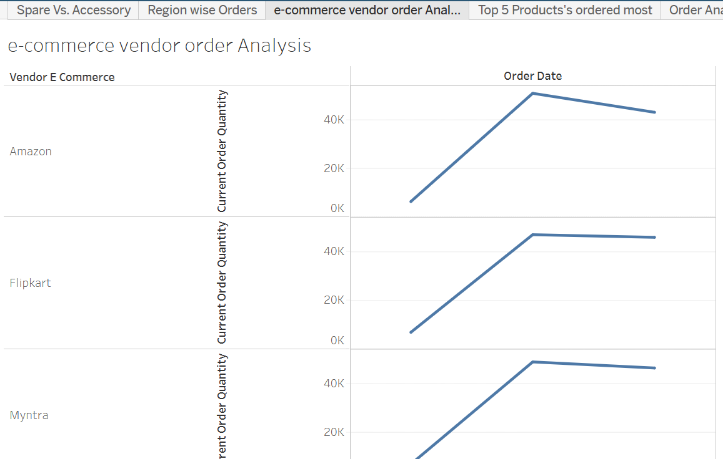
Vendor Order Quantity Analysis
Tableau Dashboard

Slide 16
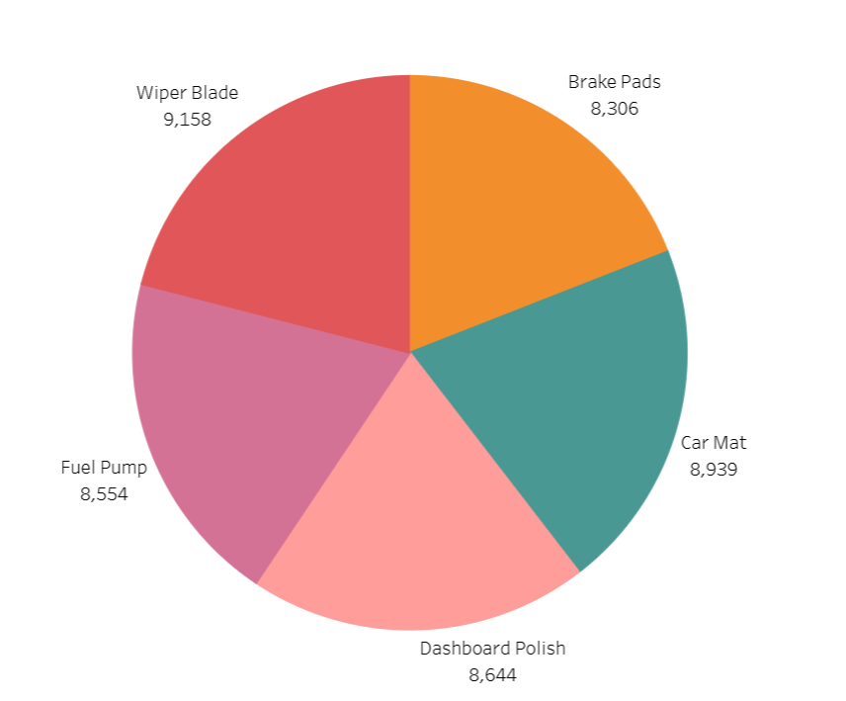
Top 5 Products Ordered
Tableau Dashboard

Slide 17


